Slide 1
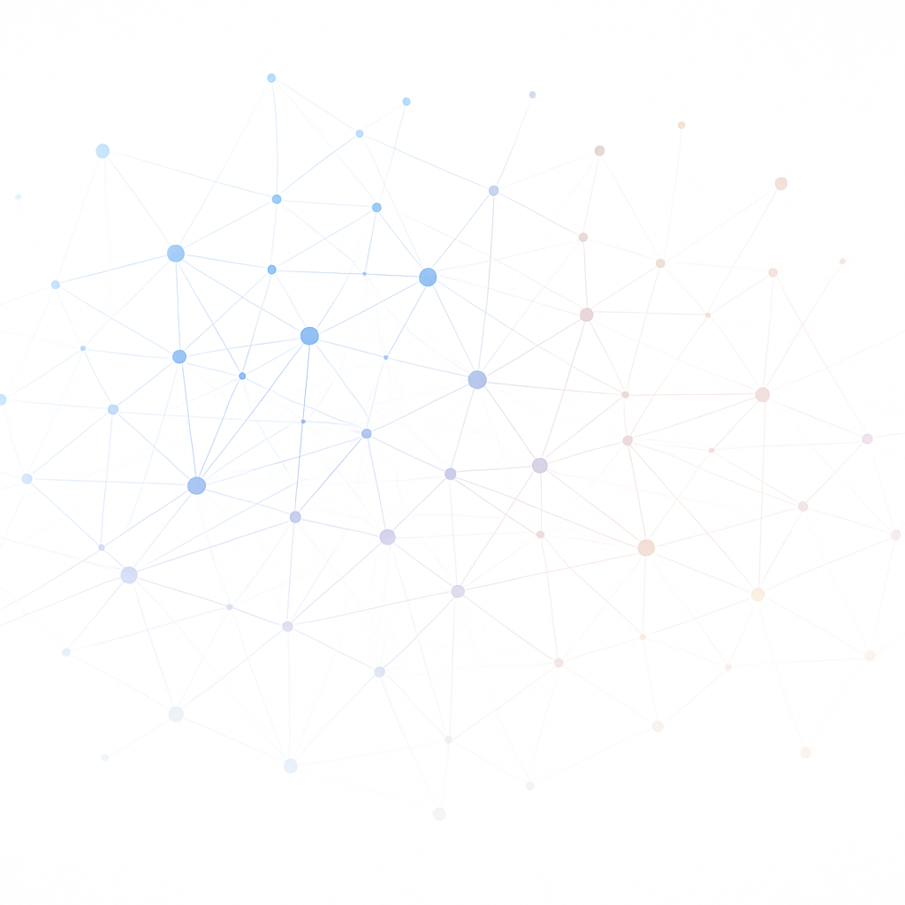
Week 1: Machine Learning Fundamentals
Supervised vs. Unsupervised Learning | Classification & Regression
CSC 422 Machine and Deep Learning

Slide 2
What is Machine Learning?
Machine learning algorithms enable computers to learn from data, make predictions, and improve performance without explicit programming.
Three main categories:
Supervised (labeled data),
Unsupervised (unlabeled data)
and Reinforcement (learning via feedback).
[1]

Slide 3


Classification vs Regression: Differences & Use Cases
Classification
Regression
Output: discrete class labels (e.g., spam/not spam).
Goal: assign each input to a category using decision boundaries.
Examples: spam detection, image recognition, medical diagnosis.
Metrics & Use: accuracy, precision, recall, F1‑score; use when the target variable is categorical or ordinal.
Output: continuous numerical values (e.g., price, temperature).
Goal: model relationships and predict numeric quantities using best‑fit lines.
Examples: house price prediction, stock forecasting, energy consumption.
Metrics & Use: MAE, MSE, RMSE, R²; choose when the target variable is continuous.
[2] [3] [4]

Slide 4
Algorithms & Use Cases
Linear Regression
Decision Tree
Random Forest
Linear relationship between target and features.
Simple and widely used for continuous outcomes.
Used for house price prediction.
Recursively splits data into a decision tree.
Interpretable; handles categorical & numeric data.
Used in credit risk analysis and decision support.
Ensemble of many decision trees.
Reduces overfitting; handles high dimensions.
Suitable for large, complex datasets.
Support Vector Machine
Naive Bayes
K‑Nearest Neighbors
Maximizes margin between classes.
Kernel trick enables non‑linear boundaries.
Used for image & text classification.
Bayesian probabilistic classifier.
Assumes independent features; efficient.
Applied to text classification & spam filtering.
Instance‑based with majority voting.
Non‑parametric & simple to implement.
Used for recommendation & anomaly detection.
[5] [6] [7] [8] [9] [10]

Slide 5
Unsupervised Learning Algorithms
Clustering
Association Rules
Dimensionality Reduction
K‑Means
Hierarchical
DBSCAN
Mean‑Shift
Spectral
Apriori
FP‑Growth
ECLAT
PCA
LDA
NMF
LLE
Isomap
[17] [18] [19]

Slide 6
Supervised vs Unsupervised: Key Differences & Use Cases
Aspect | Supervised | Unsupervised
Data | Labeled inputs with known outputs | Unlabeled, raw inputs
Goal | Predict known outputs for new inputs | Discover hidden patterns and structure
Applications | Classification & regression (e.g., spam detection, price prediction) | Clustering & association (e.g., recommendation, anomaly detection)
Complexity | Lower – feedback guides learning | Higher – no known outputs to guide learning
[20] [21] [22] [23] [24]

Slide 7
Supervised vs. Unsupervised Learning
Supervised Learning
Unsupervised Learning
Trained with labeled data; each input has a known output.
Goal: learn a mapping from inputs to outputs and evaluate accuracy.
Typical tasks: classification and regression.
Feedback: measurable performance on unseen data.
Trained on unlabeled data; no predefined outputs.
Goal: discover patterns, groups or relationships in data.
Typical tasks: clustering, association, dimensionality reduction.
Feedback: no explicit accuracy measure.
[25]

Slide 8
Classification vs. Regression
Classification
Regression
Predicts discrete categories (yes/no, labels).
Examples: spam detection, image classification.
Algorithms: logistic regression, decision trees, SVM, KNN.
Predicts continuous numeric values.
Examples: house price prediction, temperature forecasting.
Algorithms: linear regression, polynomial, ridge, lasso.
[26]

Slide 9
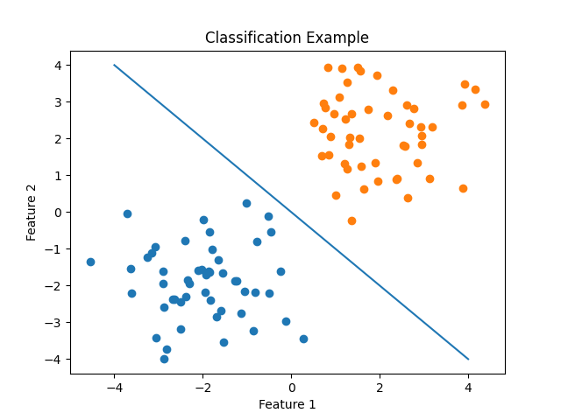
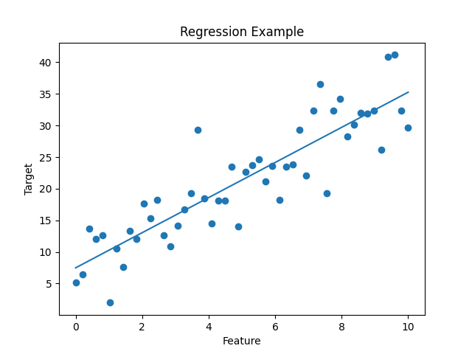
Visualizing Tasks
Classification: decision boundary separates classes
Regression: best‑fit line models continuous trends
[27] [28]

Slide 10


Labeled vs. Unlabeled Data
Labeled Data
Unlabeled Data
Contains input features and known target values (labels).
Enables supervised tasks like classification and regression.
Typically smaller and expensive to obtain.
Provides ground truth for training and evaluation.
Only input features; no target labels available.
Used for unsupervised tasks like clustering and dimensionality reduction.
Abundant and often cheaper to collect.
Requires techniques to discover hidden patterns without ground truth.
[29] [30]

Slide 11


Choosing Between Classification & Regression
1
Define the Problem Clarify what you want to predict or decide.
2
Analyze Data Examine features and understand the target variable type.
3
Identify Target Categorical targets → classification; continuous targets → regression.
4
Choose Metrics Select metrics (accuracy, F1, MAE, RMSE) appropriate for the task.
5
Validate & Generalize Use train/test splits and cross‑validation to assess performance.
[31]

Slide 12
Model Evaluation
Classification Metrics
Regression Metrics
Accuracy: fraction of correct predictions.
Precision & Recall: measure positive predictive value and sensitivity.
F1-Score: harmonic mean of precision and recall.
AUC‑ROC: trade‑off between true positive and false positive rates.
MAE & MSE: mean absolute and squared error of predictions.
RMSE: square root of average squared error.
R² Score: proportion of variance explained by the model.
[32]

Slide 13
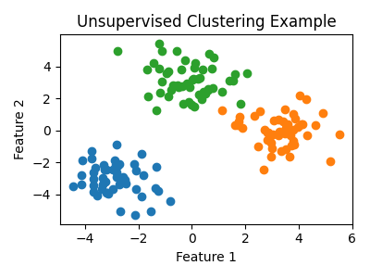
Unsupervised Learning Applications
Anomaly detection: identify unusual patterns or outliers.
Recommendation systems: suggest items based on similarity in unlabeled data.
Customer segmentation: group customers into cohorts for targeted marketing.
Scientific discovery: uncover hidden patterns or structures in complex data.
Dimensionality reduction: reduce feature space for visualization and noise reduction.
Clustering uncovers groups in unlabeled data
[33]

Slide 14
Machine Learning Workflow
1
2
3
4
5
Define Problem
Collect & Preprocess
Model Training
Evaluate & Validate
Deploy & Monitor
Set goals & outcomes.
Gather, clean & prepare data.
Choose algorithm & train model.
Use metrics & cross‑validation.
Deploy & monitor for drift.
[34]

Slide 15
Key Takeaways
Machine learning learns from data; supervised uses labeled data while unsupervised works with unlabeled data.
Classification predicts categories; regression predicts continuous values – choose based on your target variable type.
Appropriate evaluation metrics (e.g., accuracy, F1, RMSE) and cross‑validation ensure reliable model performance.
Unsupervised learning uncovers hidden patterns and enables applications like clustering, anomaly detection and recommendation systems.
Follow a structured ML workflow: define problem, prepare data, train models, evaluate, validate, deploy and monitor.
[35] [36]

